Slide 1

Social media and SAWS
Wayne Venter

Slide 2
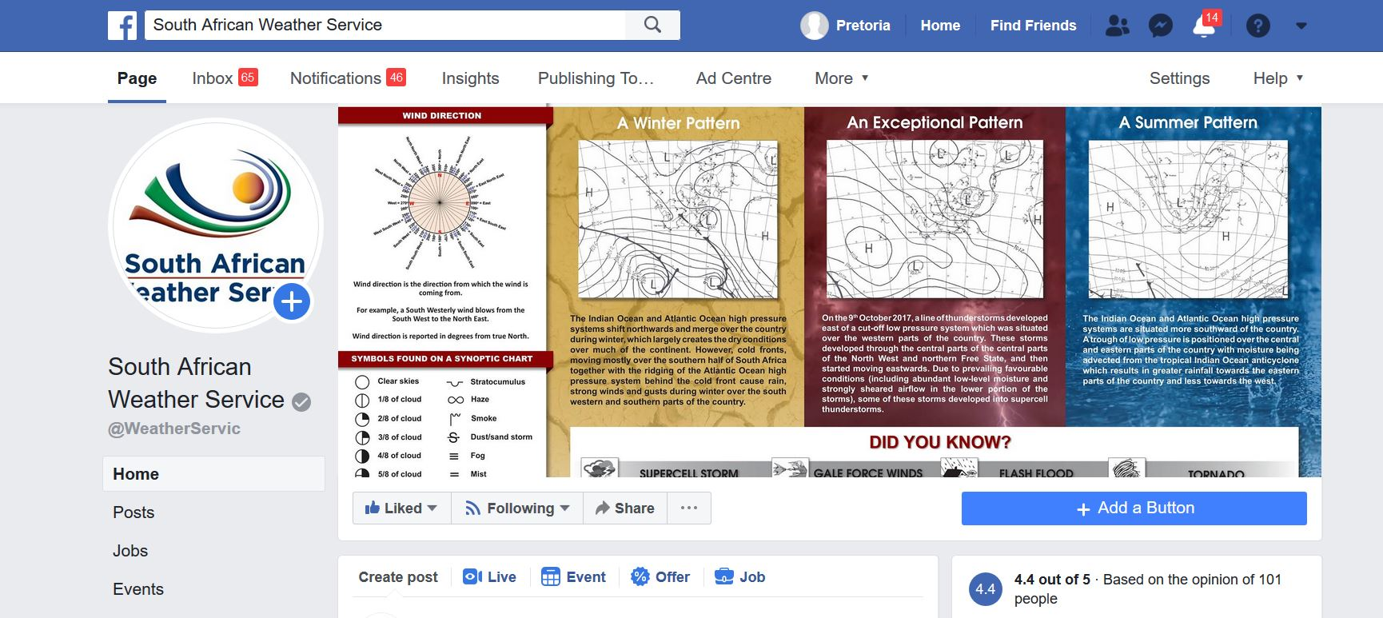
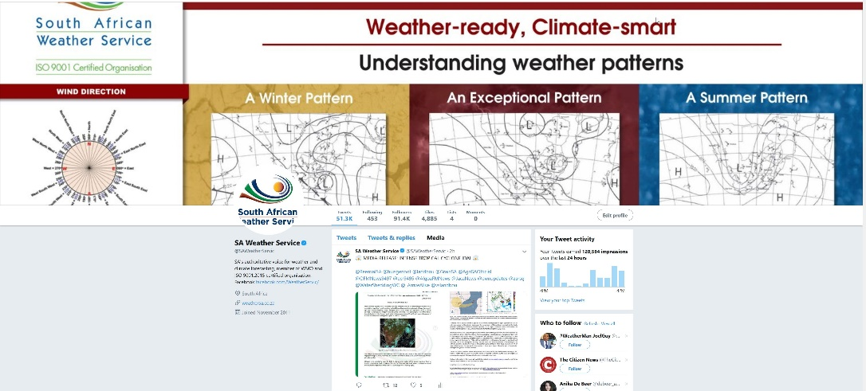
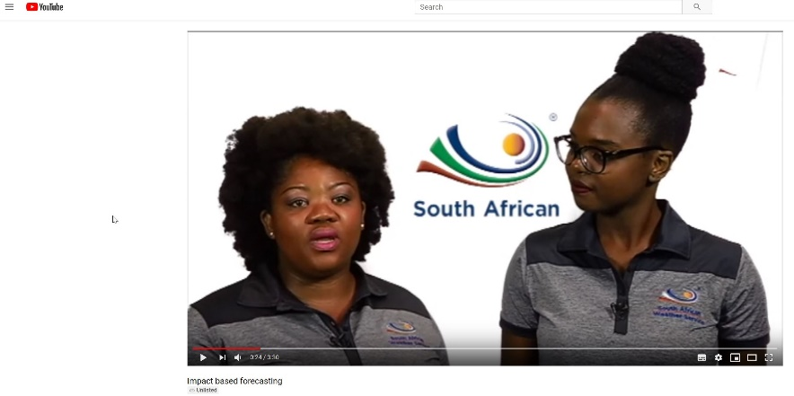
Social media products
Facebook
Twitter
Youtube (most recent)

Slide 3
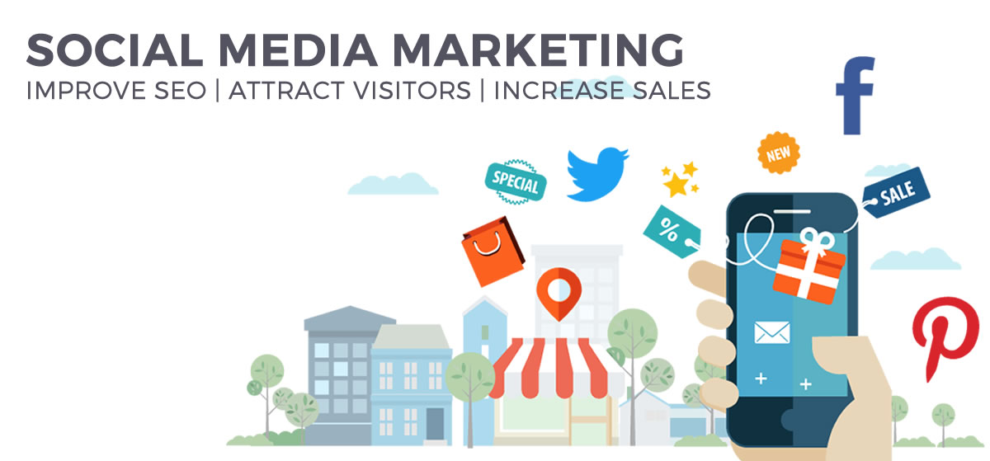
Why Social media?
Public need (especially with alerts and hoaxes).
Media and public reach increases.
Strong social media presence builds brand loyalty.
Brand image thrives on social media.

Slide 4
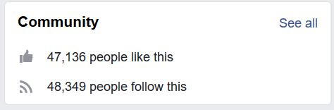
Facebook:
SAWS Facebook page was created on 30 September 2016.
Was inactive for about 6 months before forecasters started using this
platform to reach more people.
Daily weather bulletins (travellers and regional forecasts) posted.
Satellite images and rainfall observations.
Shared pictures and information from the community.
A significant increase in numbers followed with the account growing from 2000 likes/followers to 47 000 followers to date.
Current followers:

Slide 5
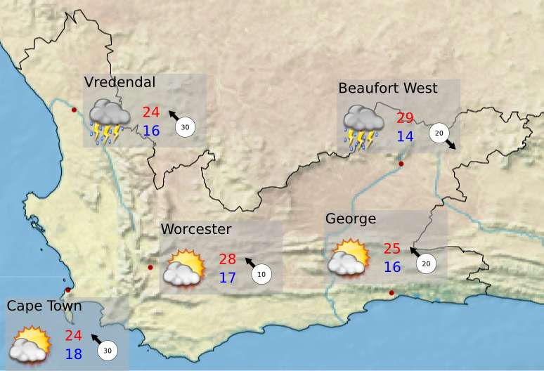
Twitter:
SAWS Twitter page was created in November 2011.
Only initial daily weather overviews images were automatically posted on
this platform.
Only extreme weather phenomena updated
on Twitter at the time.
Forecasters starting using Twitter from November 2016.
Platform showed significant growth to 91 000 followers.

Slide 6
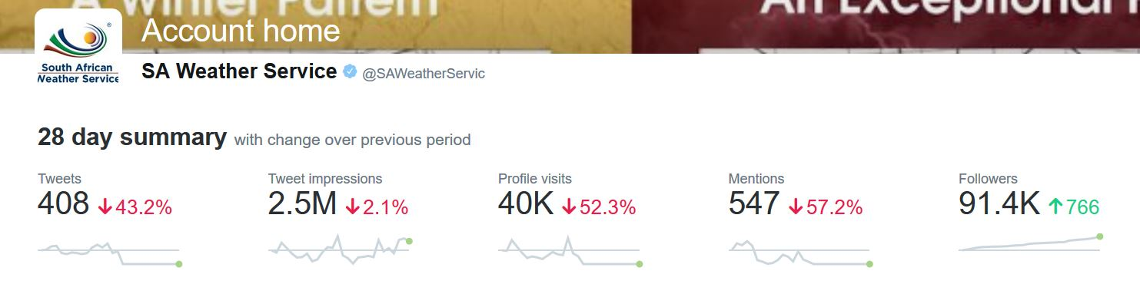
Twitter:
SAWS Twitter page grew to a current 91 000 followers over the past 2 years due to continues updates of weather and general weather based information
Rainfall observations
Satellite images
Media Releases
Daily weather bulletins
Other information (like sporting events and major weather events)

Slide 7
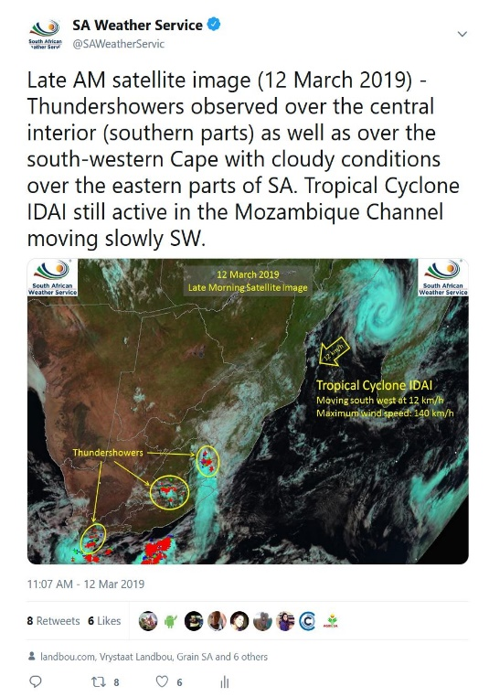
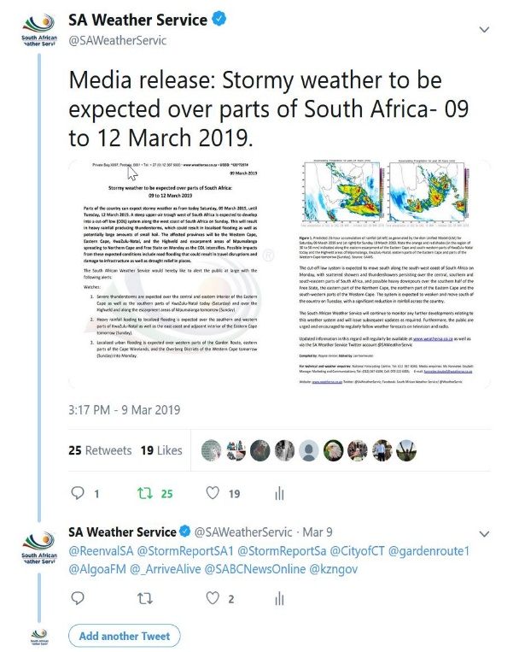
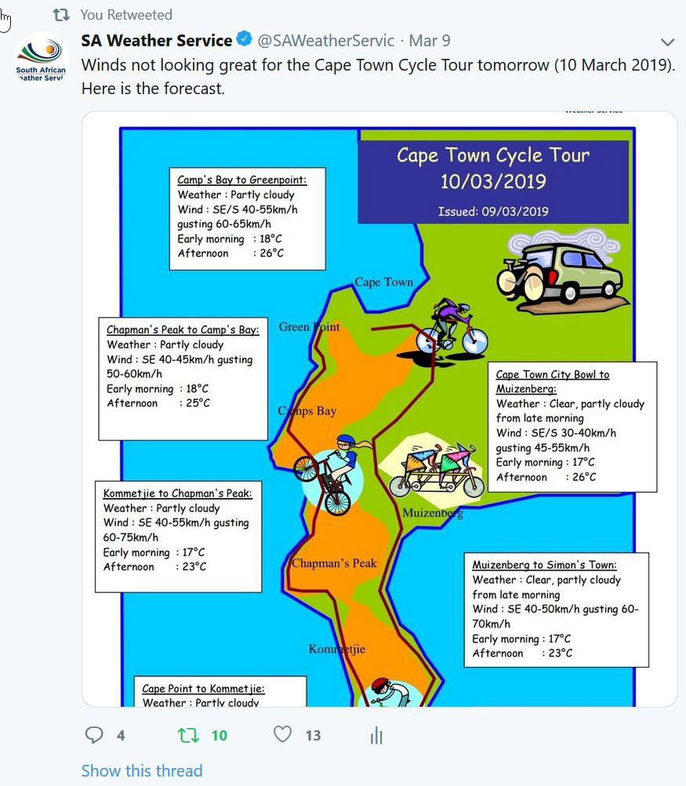
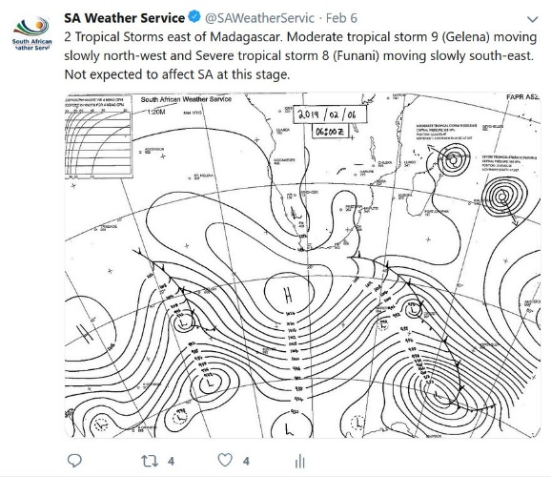
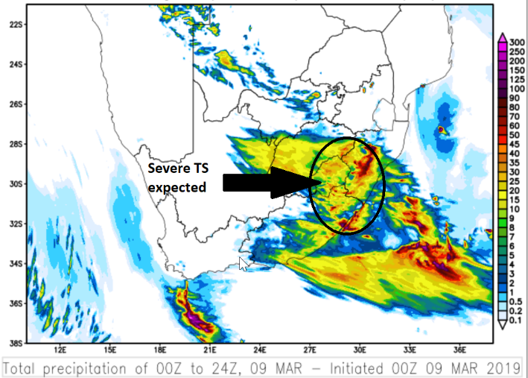
Some Examples:

Slide 8
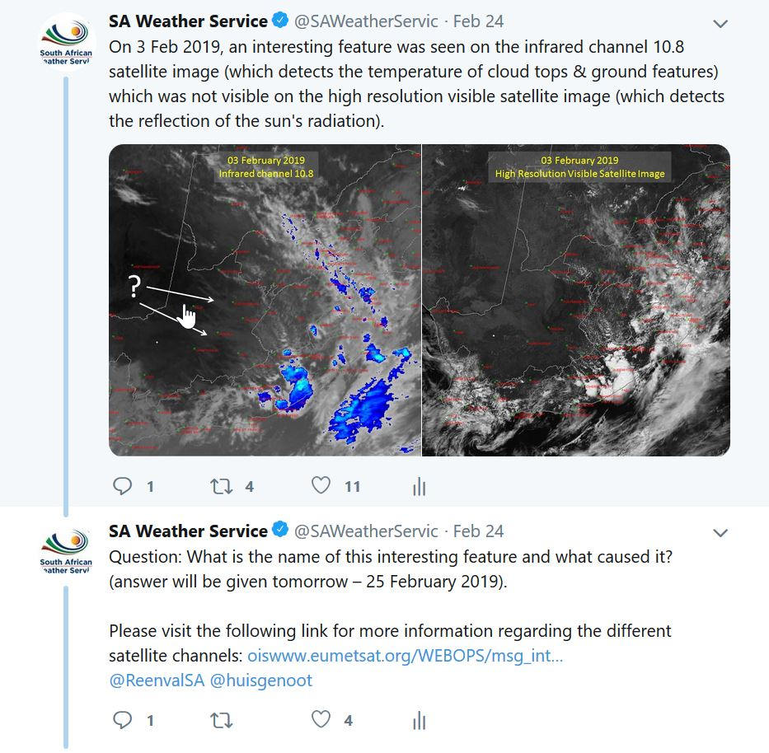
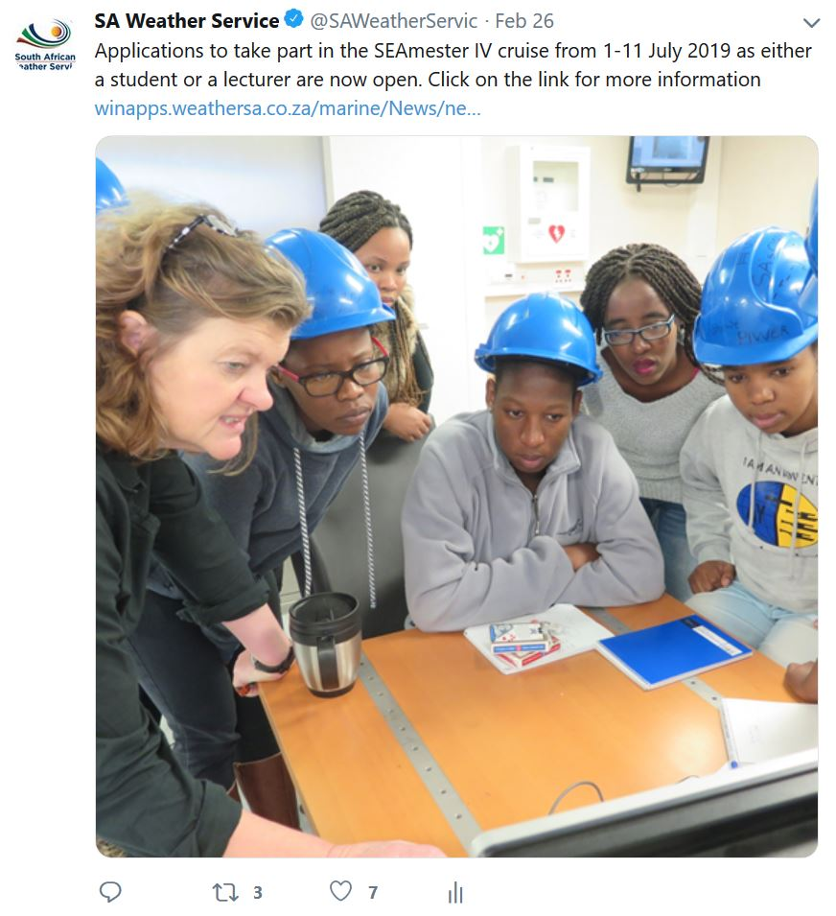
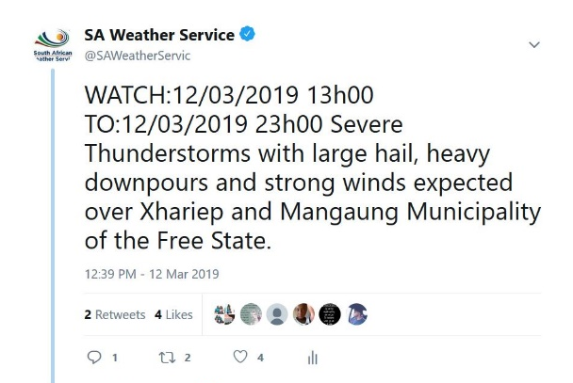
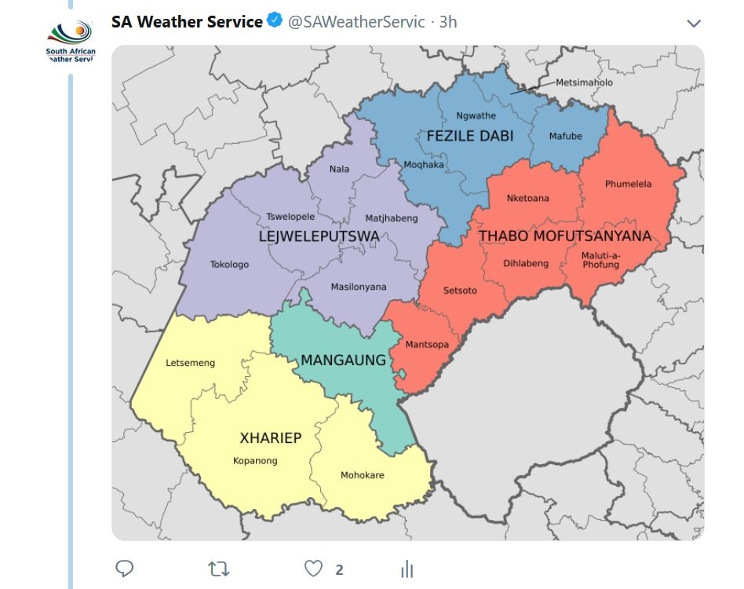
Some Examples:

Slide 9
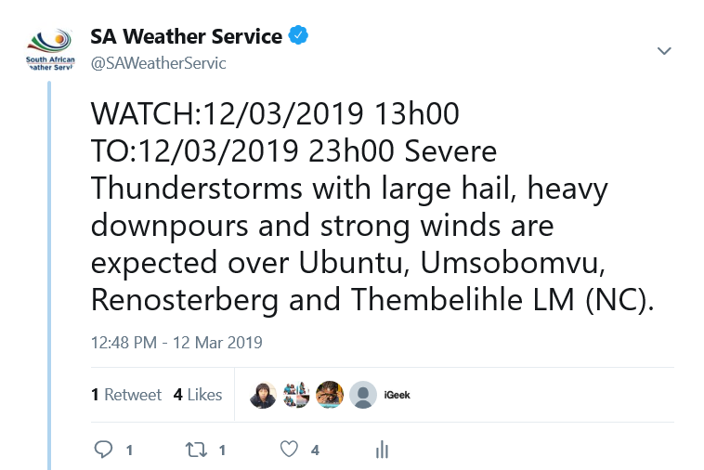
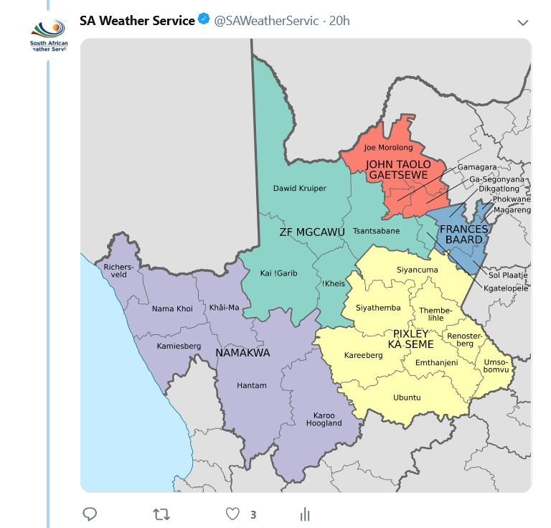
Some Examples:
Warnings issued for public use on both Twitter and Facebook
Municipality/District maps sometimes used if location is unrecognizable to
public.
Warnings indicate/procedure:
1. Time and date of severe weather events.
2. Type of severe weather event (ex: severe thunderstorms etc.).
3. What can be expected with the type of severe weather event.
4. Location of severe weather event.

Slide 10
Final thought:
Social media is valuable to any company.
Warnings issued to disaster management also issued to the public.
Social media reach increased significantly to 150 000 people.
What’s next?
Dedicated social media shifts to increase media coverage and reach.
Increase and improve media products for the public.
Main goal: Reach as many people in South Africa (especially alerts).
Thank You
End

